Slide 1
Materials Management (MM)
Curriculum: Introduction to S/4HANA using Global Bike

Slide 2
3.2 (May 2018)
SAP S/4HANA 1709
Global Bike
No Prerequisites needed

Slide 3
Bret Wagner
Stefan Weidner
Babett Ruß
Beginner

Slide 4
Describe the purchase-to-pay business process
Identify the organizational levels that support the purchase-to-pay business process
Create a material master record
Create a vendor master record
List other vendor-specific master data
Create a purchase requisition for stock and consumable materials
Create a purchase order by referencing a purchase requisition
Post a goods receipt for a purchase order
Explain the warehouse structure in Warehouse Management (WM)
Perform a putaway in WM using a transfer order (TO)
Enter a vendor's invoice
Process the automatic payment run
Explain the integration points of the purchase-to-pay business process

Slide 5
Functionality
Inventory Management
Purchasing
MRP
Physical Inventory
Valuation
Service Master
Invoice Verification
Product Catalogs

Slide 6
Unit Overview
Innovations in S/4HANA compared to ERP in Materials Management
MM Organizational Structure
MM Master Data
MM Processes
Procure-to-Pay Process

Slide 7
Innovations in S/4 HANA compared to ERP in Materials Management
Business Partner (BP) is the Single Point of Entry for master data such as customer, vendor or contact person
Transaction BP replaces: FD01, FD02, FD03, FD05, FD06, FD0 FK01, FK02, FK03, FK05, FK06, FK08 MAP1, MAP2, MAP3, MK01, MK02, MK03, MK05, MK06, MK12, MK18, MK19, V-03, V-04, V-05, V-06, V-07, V-08, V-09, V-11, V+21, V+22, V+23, VAP1, VAP2, VAP3 VD01, VD02, VD03, VD05, VD06 XD01, XD02, XD03, XD05, XD06, XD07 XK01, XK02, XK03, XK05, XK06, XK07
The maximum length of the material field (material number) has been extended from 18 to 40 characters
Data model has been changed significantly
Obligatory to use the Material Ledger
Simplifications in transactions MM01/02/03
Simplification in transaction Request for Quote
Cloud Integration: Ariba
In Output Management, the target architecture is based on Adobe Document Server and Adobe Forms
Change in the data model in MM Inventory Management
Transactions for executing and displaying goods movements are replaced by transaction MIGO
Transaction MIGO replace: MB01, MB02, MB03, MB04, MB05, MB0A, MB11, MB1A, MB1B, MB1C, MB31, MBNL, MBRL, MBSF, MBSL, MBST, MBSU

Slide 8
Innovations in S/4 HANA compared to ERP in Materials Management
The transaction for Business Partner (BP) is the Single Point of Entry for all master data such as customer, vendor or contact person and has replaced over 50 ERP transactions
The maximum length of the material field (material number) has been extended from 18 to 40 characters
The ERP data model has been simplified in many areas to improve performance
Valuation of inventory now uses the Material Ledger which was optional in ERP
The transaction for Request for Quote has been simplified and now enables Cloud Integration to Ariba
Over 15 transactions for executing and displaying goods movements are replaced by transaction MIGO
Alternative to slide 7

Slide 9
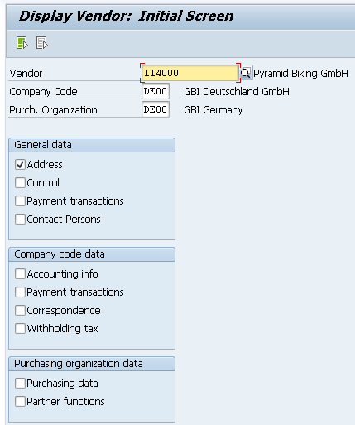
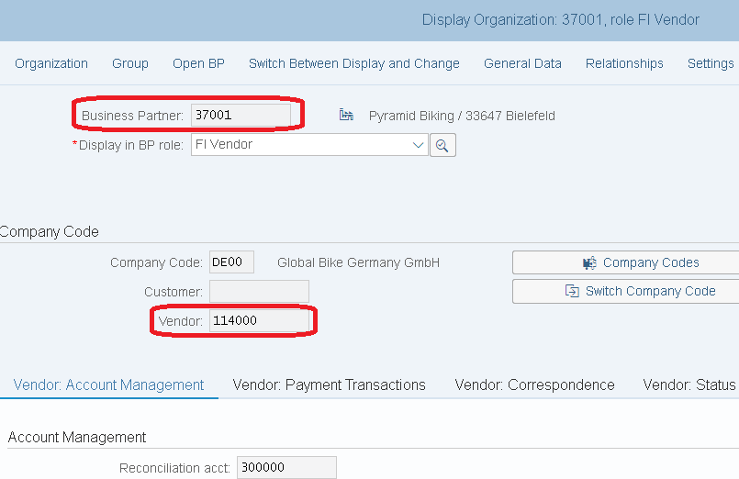
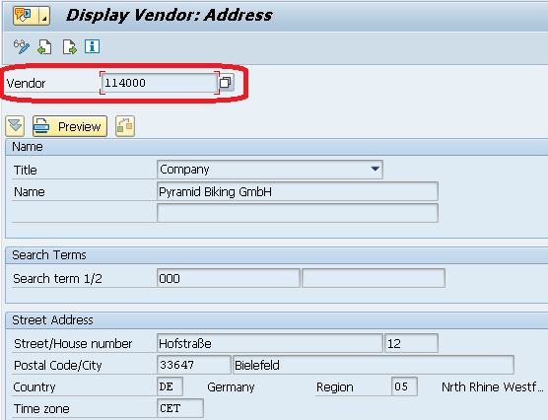
Innovations in SAP S/4HANA Business Partner
The core function of SAP S/4HANA is the simplification of data structures
various transactions, such as the management of customers or suppliers, are brought together
It is (so far) still possible to navigate through the well-known Easy Access menu
A unique business partner number is assigned to creditor 114000. This business partner number is assigned to various roles such as the customer, creditor, contact person.
Relationship: n:m

Slide 10
Innovations in SAP S/4HANA Business Partner
There are redundant object models in the traditional ERP system where the vendor master and customer master is used.
The (mandatory) target in SAP S/4HANA are the Business Partner approach.
Business partners can be categorized as a person, group, or organization as follows:
An organization represents units such as a company (for example, a legal person), parts of a legal entity (for example, a department), or an association. Organization is an umbrella term to map every kind of situation in the day-to-day business activities.
A group represents a shared living arrangement, a married couple, or an executive board.

Slide 11
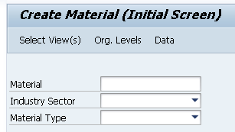
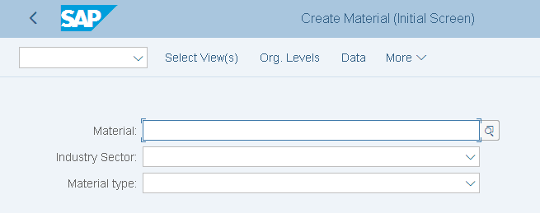
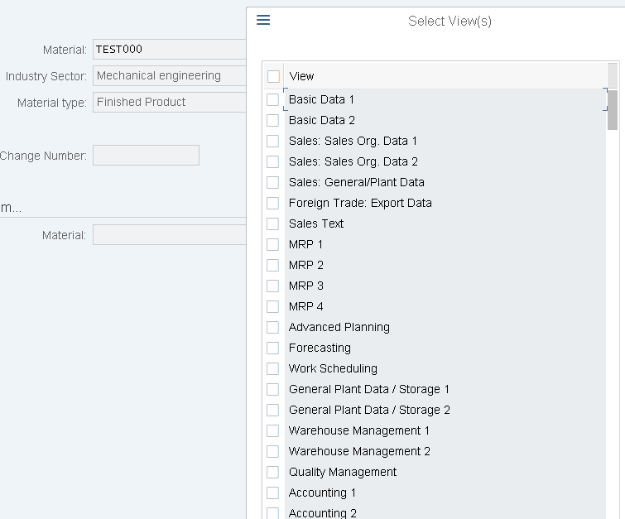
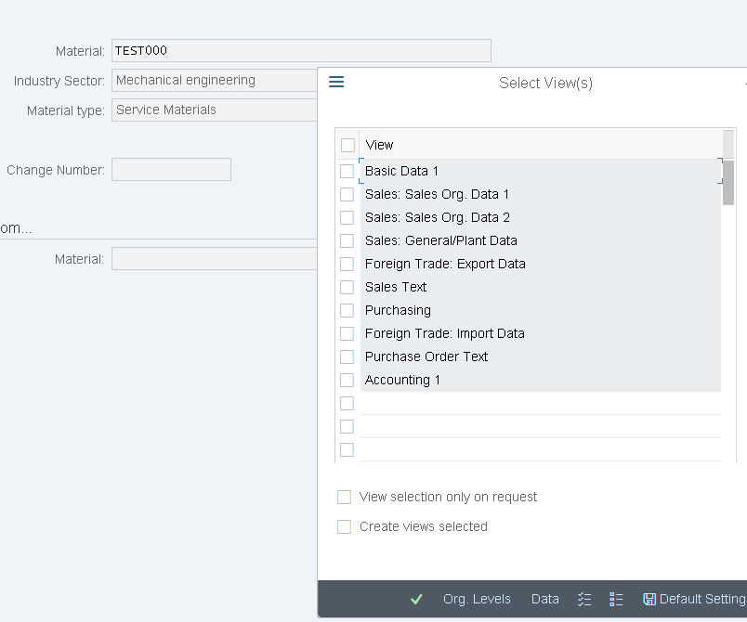
Innovations in SAP S/4HANA
The maximum length of the material field (material number) has been extended from 18 to 40 characters
Simplifications in transactions MM01/02/03
Relevant views are displayed only for material
type, e.g. Material type SERV (Service material)
→ New product type group that relates to services

Slide 12
Innovations in SAP S/4HANA
Data model has been changed significantly
the new denormalized table, MATDOC, has been introduced which contains the former header and item data of a material document as well as a lot of further attributes.
Material document data will be stored in MATDOC only and no longer in MKPF and MSEG.
Actual stock quantity data will be calculated on-the-fly from the new material document table MATDOC
With the new MM-IM data model, the system works on database level in an INSERT only mode without DB locks.
Obligatory to use the Material Ledger
This simplification makes it obligatory to use the Material Ledger in all SAP S/4HANA systems.
Material Ledger, as the inventory subledger, valuates material inventories in multiple currencies and GAAPs in parallel
In addition, Material Ledger is a base prerequisite for the use of Actual Costing.
tables need to be updated less often, which leads to a higher throughput due to fewer database locks.
In MM02 and MR21, material prices can now be maintained in multiple currencies.
The inventory account balances are calculated separately for each currency and result, therefore, in a cleaner and more consistent valuation in currencies other than the local currency.

Slide 13
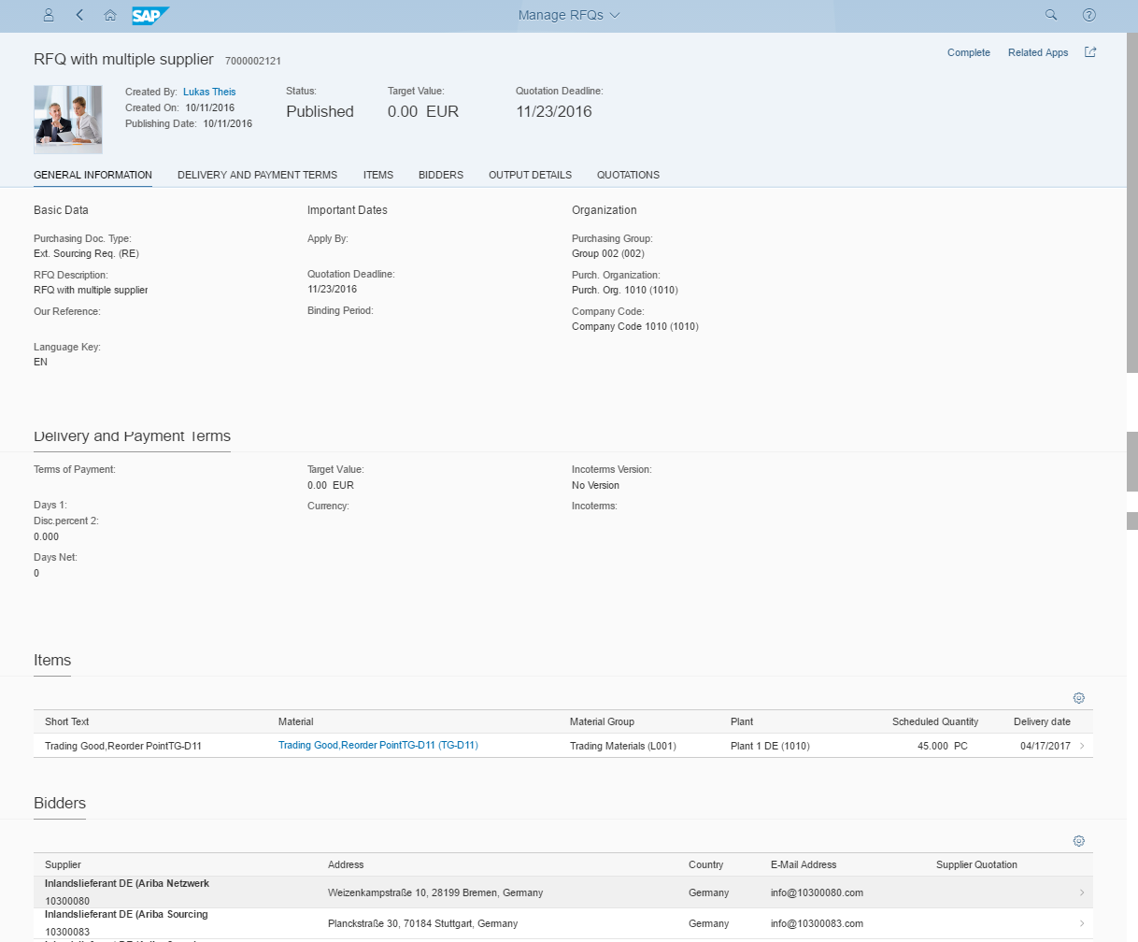
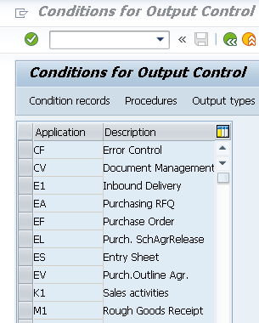
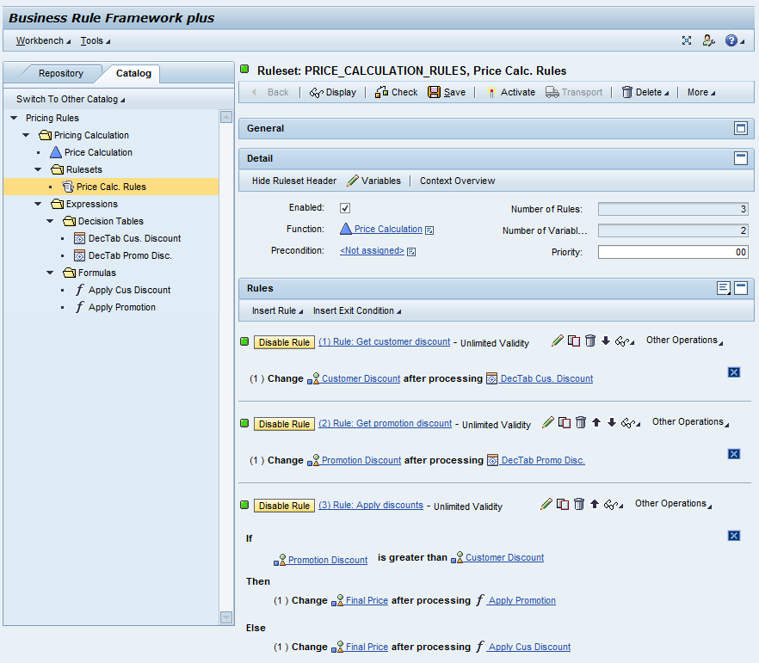
Innovations in SAP S/4HANA
Simplification of the Request for Quote transaction
So far supplier field is mandatory
Only one supplier offer per request could be maintained
Now you can send one RFQ via Fiori App to different suppliers
Output Management in S/4HANA is based solely on Adobe Document Server and Adobe Forms
NAST (message control) is not supported any further
BRFplus (Business Rule Framework plus) is the new standard
Intrasystem, can be used by all SAP applications that are
based on SAPNetWeaver
Also generate web services that can be offered in
SOA principle in system landscape, regardless of the
software platform

Slide 14
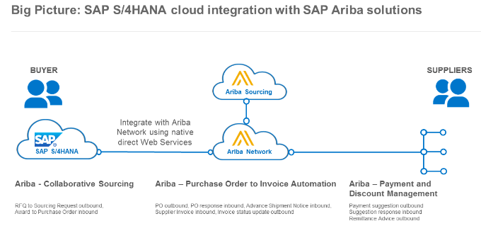
Innovations in SAP S/4HANA
Cloud Integration: Ariba
Ariba allows to discover new suppliers, the streamlining of transaction processes, and the realization of savings with cloud-based procurement software
The Ariba network supports the entire source-to-pay process.

Slide 15
Innovations in SAP S/4HANA
Performance optimizations within Material Document Processing - lock behaviour
no UPDATE processes on the actual stock quantity fields INSERT Only
from a data base perspective there are no locks enables - from a DB perspective - parallel execution of material document processing
logical locks still required because:
The consistency check with master data and stock quantity (1 + 3) is necessary in any case. The defined sequence of material documents (2) is ensured only in the case that exclusive lock is chosen in the customizing
Consistency with material master data by parallel change --> locigal lock at one field
Defined sequence of material documents (e.g. for moving average price).
Consistency with stock quantity (check availability if negative stock is not allowed).
Transactions for executing and displaying goods movements are replaced by transaction MIGO
Transaction MIGO replace: MB01, MB02, MB03, MB04, MB05, MB0A, MB11, MB1A, MB1B, MB1C, MB31, MBNL, MBRL, MBSF, MBSL, MBST, MBSU

Slide 16
MM Organizational Structure (Materials Mgmt.)
Client
An independent environment in the system
Company Code
Smallest org unit for which you can maintain a legal set of books
Plant
Operating area or branch within a company
Manufacturing, distribution, purchasing or maintenance facility
Storage Location
An organizational unit allowing differentiation between the various stocks of a material in a plant

Slide 17
MM Organizational Structure (Purchasing)
Purchasing Organization
The buying activity for a plant takes place at the purchasing organization
Organization unit responsible for procuring services and materials
Negotiates conditions of the purchase with the vendors
Purchasing Group
Key that represents the buyer or group of buyers who are responsible for certain purchasing activities
Channel of communication for vendors
Notes:
Internal Document instructing the purchasing department to request a specific good or service for a specified time
Requisitions can be created two ways:
Directly - Manually
person creating determines: what, how much, and when
Indirectly - Automatically
MRP
Production Orders
Maintenance Orders
Sales Orders

Slide 18
GBI Structure for Materials Management
Global Bike
Client
Global Bike Inc.
Global Bike Germany GmbH
Company
Code
Dallas
San Diego
Miami
Heidelberg
Hamburg
Plant
Raw Materials
Trading Goods
Trading Goods
Raw Materials
Trading Goods
Storage
Location
Semi-fin. Goods
Finished Goods
Finished Goods
Semi-fin. Goods
Finished Goods
Finished Goods
Miscellaneous
Miscellaneous
Finished Goods
Miscellaneous
Miscellaneous
Miscellaneous

Slide 19
GBI Enterprise Structure in SAP ERP (Logistics)
Shipping Point
DL00
MI00
SD00
TO00
HD00
HH00
PE00
RM00
TG00
TG00
TG00
RM00
TG00
TG00
Storage
Location
SF00
FG00
FG00
FG00
SF00
FG00
FG00
FG00
MI00
MI00
MI00
FG00
MI00
MI00
MI00
MI00
Central Purchasing Organization (global) GL00
Purchasing Org. US00
CA00
PO DE00
AU00
Purchasing Group North America
N00
PGr Europe
E00
Asia
A00
Dallas
DL00
Miami
MI00
S. Diego
SD00
Toronto
TO00
Heidelb.
HD00
Hamburg
HH00
Perth
PE00
Plant
CC US00
CA00
CC DE00
AU00
Company Code
Client GBI
Notes:
Organizational units displayed in grey are not yet implemented, but are already planned in GBI.

Slide 20
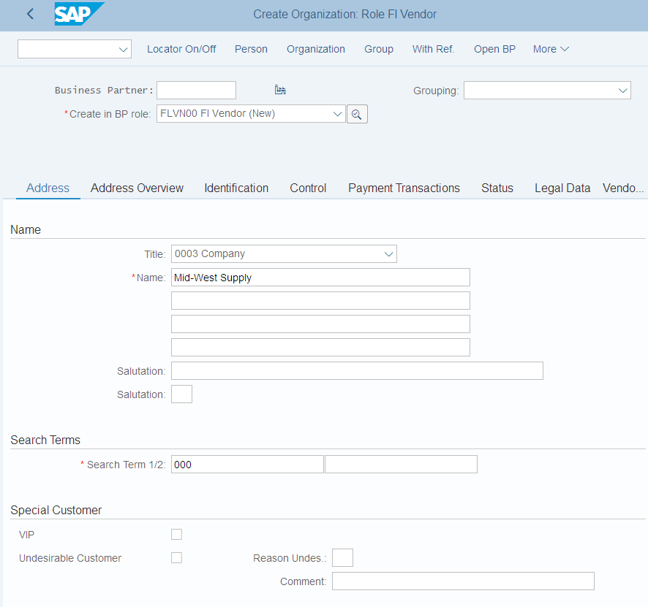
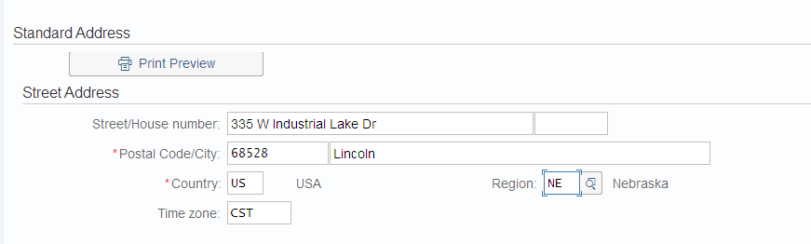
Vendor Master Data
Vendor Master
Contains all the necessary information needed to business with an external supplier
Used and maintained primarily by the Purchasing and Accounting Departments
Every vendor MUST have a master record
One-time vendor possible

Slide 21
Vendor Master Views
Client Level
Address
Vendor Number
Preferred Communication
Company Code Data
Reconciliation Account
Terms of Payment
Bank Account
Purchase Org Data
Purchasing Currency
Salesman’s Name
Vendor Partners
General Data
Company Code Data
Financial Accounting (FI)
Purchasing Data
Materials Mgmt (MM)

Slide 22
Vendor Master
General Information relevant for the entire organization:
Name Address Communication
Client XXX
Company Code specific information:
Acc. Mgmt Payment Bank
Purch. Organization specific information:
Incoterms Currency
Company Code US00
Purch. Org. US00
Company Code DE00
Purch. Org. DE00

Slide 23
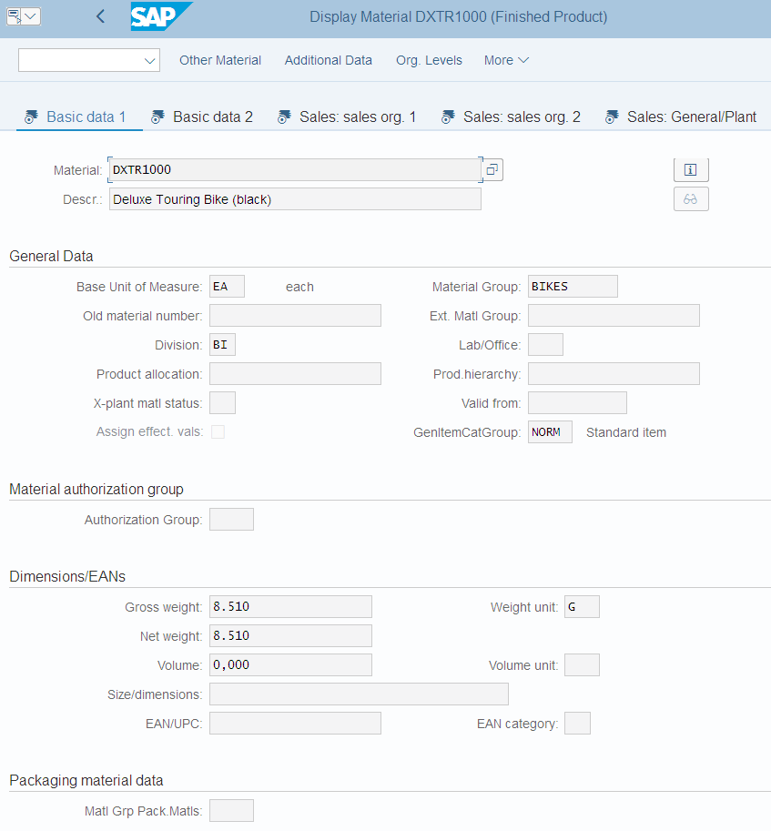
Material Master Data
Material Master
Contains all the information a company needs to manage a material
It is used by most components within the SAP system
Sales and Distribution
Materials Management
Production
Plant Maintenance
Accounting/Controlling
Quality Management
Material master data is stored in functional segments called Views

Slide 24
Material Master Views
Sales Data
Basic Data
Purchasing Data
Material Master
Mat. Plan. Data
Forecasting Data
Storage Data
Controlling Data
Quality Data
Accounting Data

Slide 25
Material Master
General Information relevant for the entire organization:
Name Weight Unit of Measure
Client XXX
Sales specific information:
Delivering Plant Loading Grp
Storage Location specific information:
Stock Qty
Sales Org. UW00
Storage Loc. FG00
Sales Org. UE00
Storage Loc. TG00
Notes:
All of this together makes up the Master Record for a Material.

Slide 26
Purchasing Information Record
Framework for Purchase Order
Contains the relationship between a vendor and a material
Can be created:
Manually
Automatically – Quotations and contracts
Automatically – Purch. Orders
Reporting
Vendor Evaluation
Purchasing
Information Record
Material Master
Vendor Master

Slide 27
Purchasing Information Record
Allows buyers to quickly determine:
Which vendors have offered or supplied specific materials
Info Records contain:
Data on pricing and conditions
Last purchase order
Tolerance limits for deliveries
Specific lead times
Availability periods
Vendor Evaluation data
Serves as default information for Purchase Orders

Slide 28
Master Data in Use
Purchase
Order
45......01
Material Master
Vendor Master
Purchasing
Information Record

Slide 29
Procure-To-Pay Process
Purchase
Requisition
Vendor
Selection
Purchase
Order
Notify
Vendor
Payment
to Vendor
Invoice
Receipt
Vendor
Shipment
Goods
Receipt
Notes:
This is a standard view of the procure to pay process and the most common. It may vary significantly based upon the company procedures, the products/services purchases and other factors and SAP allows businesses to tailor the product to their needs.
In the procure to pay process, there is a standard control mechanism called a three way match. In standard SAP, before a vendor is paid for the goods, the system will check that the Purchase Order, Goods Receipt and the Invoice Receipt details all match – in particular to the quantities received and the prices being charged. Any mismatch will block the supplier from being paid.
The process starts with a requisition or demand that needs to be filled. This demand come from Planning (MRP), manually or automatically form other parts of SAP like PP and PM.
The purchase order is the document used to commit to a supplier to deliver the goods. The order includes the vendor, price, quantity, terms and other pertinent information which will be used later as part one of the 3-way match.
Using the SAP Output control functions, the vendor is notified be email or some other means.
The goods are shipped and delivered to the buyer where they are received (typically at the dock) and then put away. The goods receipt is part two of the three way match.
An invoice is received from the vendor which is the third part of the 3-way match. After the tolerances/verification of the 3-way match are met a payment is made according to the terms agreed to in the purchase order.

Slide 30
Purchase Requisition
Internal Document requesting the purchasing department to procure a specific good or service for a specified time
Requisitions can be created two ways:
Directly - Manually
person creating determines: what, how much, and when
Indirectly - Automatically
MRP
Production Orders
Maintenance Orders
Sales Orders
Notes:
Requisitions can be created indirectly in the following ways:
Via materials planning and control
The component Consumption-Based Planning suggests materials that need to be ordered on the basis of past consumption or usage figures and existing stock levels. The order quantity and the delivery date are determined automatically.
Via networks (from the component PS Project System)
Requisitions are generated automatically from networks if:
A material component with non-stock material or an external service component has been assigned to an operation and the indicator allowing automatic generation of requisitions immediately the network is saved has been set in the network.
Via maintenance orders
Requisitions are generated automatically from maintenance orders if:
A material component with non-stock material has been assigned to an operation, or
An operation with the control key for external services has been created.
For further information, refer to the section Planning of an Order in the PM Maintenance Orders documentation.
Via production orders (from the component PP Production Planning and Control).
Requisitions are generated automatically from production orders if:
They contain an external processing operation (e.g. subcontracting work). A precondition is that the control key for the operation allows or prescribes external processing.
They contain non-stock components.

Slide 31
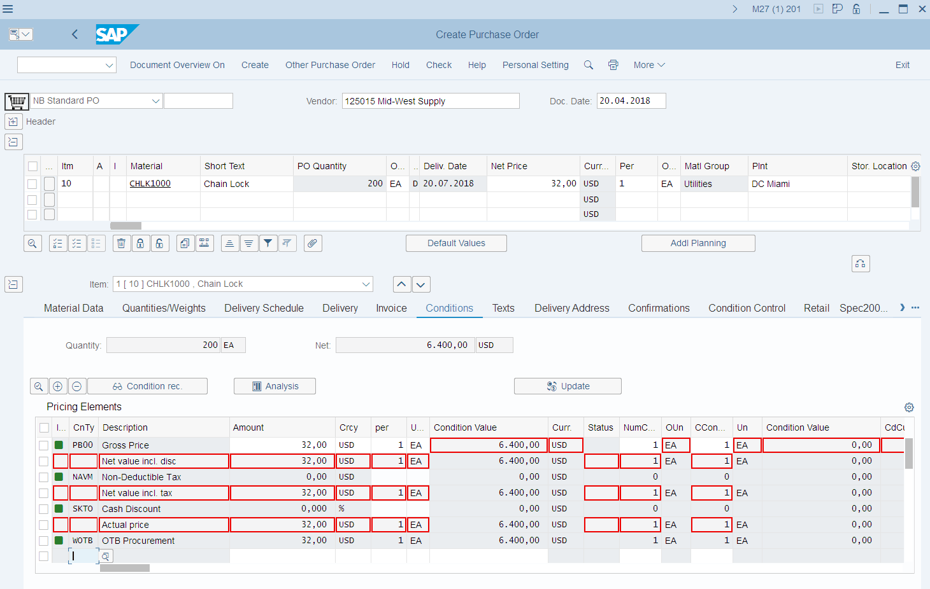
MM Master Data
Vendor Master Data
Material Master Data
Purchasing Info Record
Condition Master Data
Output Master Data

Slide 32
Requisition Sourcing
Once the requisition has been assigned a source of supply it can be released for processing
There are a variety of ways that a purchasing department can process a requisition to determine the appropriate Source of Supply:
Internal Sourcing Requirements
Source List
Outline Agreement
RFQ

Slide 33
Internal Sourcing
The requisition for materials could be satisfied by sources within our company.
It is possible that a plant within your firm could represent a potential source of supply for the material needed (centralized warehouse)
If an internal source is identified the requirement is covered by an internal procurement transaction (stock transport order)

Slide 34
Source List
A source list is a record that specifies the allowed means for procuring a material for a certain plant within a given time period.
If the list contains a sole source the system will assign the vendor to the requisition.
If several options exist the system will display a list of vendors for you to choose from.
If no source has been established the system will revert to search information records and outline agreements.

Slide 35
Outline Agreement
Requisitions can be satisfied through existing longer-term purchasing agreements
These agreements are subdivided into:
Contracts
Consists of items defining the individual materials, material groups, or services with prices
Quantity
Value
Scheduling Agreements
Total quantity of material is spread over a certain period in a delivery schedule, consisting of line items indicating quantities and their planned delivery date
Notes:
An outline purchase agreement is a longer-term agreement between a purchasing organization and a vendor regarding the supply of materials or the performance of services within a certain period according to predefined terms and conditions.
Agreements are subdivided into:
- Contracts - Centrally agreed contracts ; Distributed contracts
quantity, or value
You can also set up corporate buying contracts with your vendors. These are valid for all plants and company codes within a client (see Centrally Agreed Contract).
Over the contract validity period, certain quantities of the materials or services covered are released (called off) against the contract as and when required through the issue of purchase orders referencing the latter. Such purchase orders are thus termed "contract release orders" or simply "release orders". (Outside SAP, particularly in the UK; they may also be referred to as "call-off orders".)
- Scheduling agreements - Scheduling agreement referencing a centrally agreed contract
outline purchase agreement under which materials are procured on predetermined dates within a certain time period.
Delivery of the total quantity of material specified in a scheduling agreement item is spread over a certain period in a delivery schedule, consisting of lines indicating the individual quantities with their corresponding planned delivery dates.

Slide 36
Request for Quotation
If nothing exists in the system we may need to submit a request for quotation to our vendors. An RFQ is an invitation to a vendor by a Purchasing Organization to submit a bid for the supply of materials or services
The accepted quotations will generate Purchasing Information Records
Buyers can perform Quotation Price Comparisons
Buyers can finally select a vendor quotation
P.O.
45…12
Quote
Pur
Req.
RFQ
Vendor 1
Vendor 2
Vendor 3
Quote
Eval.
generate
Quote
Reject
Letter
Notes:
A quotation is legally binding on the vendor for a certain period.
A quotation consists of items in which the total quantity and delivery date of an offered material or service are specified
Determining which vendors to send RFQs to is the first step in the bidding process.
The system can help you to choose which vendors are to receive an RFQ if some or all of the information set out below is available:
- Info records
- Source list

Slide 37
Quotation from Vendor
The quotation received by your company is a legally binding offer, should decide to do business with the vendor, containing price’s and conditions for the materials specified in the RFQ for a predefined period of time.
In SAP the RFQ and the Quotation will be become a single document, you will enter the vendor’s response in the RFQ you created.

Slide 38
Vendor Evaluation once Identified
Vendor evaluation helps purchasing evaluate vendors for sourcing while also enabling the company to monitor vendor relationships through performance scores and criteria you put in place.
Supports a maximum of 99 main criteria and 20 sub criteria for each main:
Price
Price Level
Price History
Quality
Goods Receipt
Quality Audit
Complaints/Rejection level
Delivery
On-time delivery performance
Quantity reliability
Compliance with shipping instructions
Confirmation Date
You then must establish a scoring range (1 -100) and determine the weight factors of scores for each.
Notes:
Price Level
This subcriterion compares relationship of a vendor's price to the market price. If the vendor's price is lower than the market price, he/she receives a good score; if it is higher than the market price he/she is assigned a poor score.
On the basis of the subcriterion Price Level you can compare a vendor's price to the current market price at a certain point in time.
Price History
This subcriterion compares the development of the vendor's price with the market price.
On the basis of the subcriterion Price History, you can determine whether the vendor's price has increased or decreased over a certain period in comparison with changes in the market price over the same period.
Goods Receipt
This subcriterion is used to evaluate the quality of the material that the vendor delivers. Quality inspection takes place at the time of goods receipt.
Quality Audit
This subcriterion is used to evaluate the quality assurance system used by a company in manufacturing products.
Complaints/Rejection Level
This subcriterion is used to evaluate whether the materials delivered by the vendor are regularly found to be faulty subsequent to incoming inspection (for example, on the shop-floor) leading to additional expense and loss of time (due to loss of production, reworking etc.). The score (QM key quality figure) is calculated in QM Quality Management and the data passed on to MM Vendor Evaluation. This key quality figure is converted for use in the Vendor Evaluation scoring system.
On-Time Delivery Performance
This subcriterion is used to determine how precisely a vendor has adhered to the specified delivery dates.
Quantity Reliability
This subcriterion is used to determine whether a vendor has delivered the quantity specified in the purchase order.
“On-time delivery performance” and “Quantity reliability” always have to be seen in conjunction. You can specify for each material (in the material master record) or for all materials (in the system settings) the minimum quantity of the ordered materials that must be delivered in order for a goods receipt to be included in the evaluation. This enables you to avoid a situation in which a punctual goods receipt involving only a small quantity of ordered materials is included in the evaluation with a good score for “on-time delivery performance”. If this minimum quantity is not delivered, the vendor is not awarded a score. However, in this case the vendor receives a bad score for quantity reliability.
Compliance With Shipping Instructions
This subcriterion is used to determine how precisely a vendor complies with your instructions for the shipping or packing of a material.
Confirmation Date
This subcriterion is used to determine whether a vendor adheres to a previously confirmed delivery date (that is, whether the goods are actually received on the date previously confirmed by the vendor).

Slide 39
Purchase Order
A purchase order is a formal request to a vendor for a specific material or service under the stated conditions
Purchase Orders can be created manually
Reference a Purchase Order
Reference a Purchase Requisition
Reference a RFQ/Quotation
Without Reference
Purchase Orders can be created automatically
Notes:
The purchase order can be used for a variety of procurement purposes. You can procure materials for direct consumption or for stock. You can also procure services. Furthermore, the special procurement types "subcontracting", "third-party" (involving triangular business deals and direct-to-customer shipments) and "consignment" are possible.
You can use purchase orders to cover your requirements using external sources (i.e. a vendor supplies a material or performs a service). You can also use a purchase order to procure a material that is needed in one of your plants from an internal source, i.e. from another plant.

Slide 40
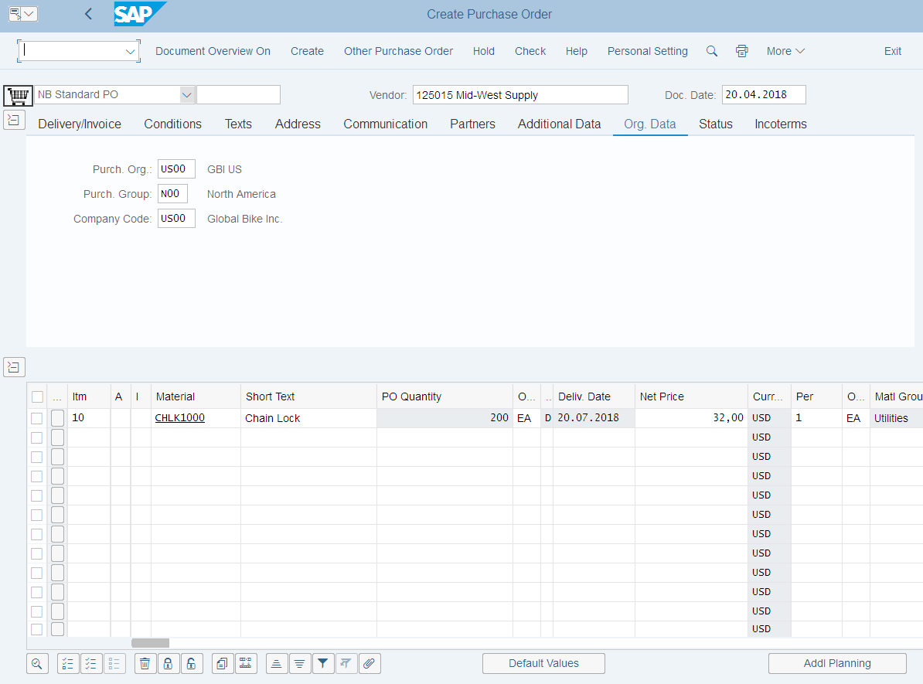
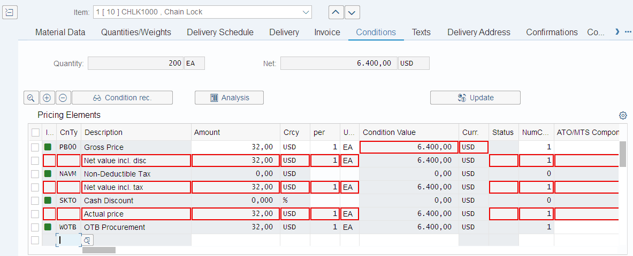
Purchase Order
A purchase order can be used for a variety of purposes, the item category (procurement type) defined in the PO will dictate the use of the order and the process that the order will follow:
Standard
Stock or Consumption
Services
Subcontracting
Third-Party
Consignment

Slide 41
Purchase Order Structure
Header
Vendor Date
Doc. Number Currency
Terms of Payment PO Price
Purchase
Order
45......01
Item Overview
Materials Price/UofM
Quantities
Delivery Date
Item Details
PO History Tolerances
Item Price
Delivery Schedule

Slide 42
Purchase Order Output
Once a Purchase Order has been created the vendor needs to be notified
Printed
E-mail
EDI
XML
There are a variety of forms that aid in the purchasing process and are generated from the Purchase Order
Purchase Order Output
Order Acknowledgement Forms
Reminders
Schedule Agreements

Slide 43


Goods Receipt
Purchase
Order
45......01
Notify Vendor
Vendor
Goods Receipt
Shipment

Slide 44
Goods Receipt
Goods movement in which we accept goods into our system
If materials are delivered against a Purchase Order we will reference that Order
Determine if we got what we ordered
System can purpose data for us from the PO
Material, quantity
Purchase Order History is updated with the receipt
Updates Physical Inventory
Updates Inventory G/L Account
Notes:
If a material is delivered for a purchase order, it is important for all of the departments involved that the goods receipt entry in the system references this purchase order, for the following reasons:
- Goods receiving can check whether the delivery actually corresponds to the order.
- The system can propose data from the purchase order during entry of the goods receipt (for example, the material ordered, its quantity, and so on). This simplifies both data entry and checking (overdeliveries and underdeliveries).
- The delivery is marked in the purchase order history. This allows the Purchasing department to monitor the purchase order history and initiate reminder procedures in the event of a late delivery.
- The vendor invoice is checked against the ordered quantity and the delivered quantity.
- The goods receipt is valuated on the basis of the purchase order price or the invoice price.

Slide 45
Material Movements
When a goods movement takes place it is represented by a Movement Type
Movement types are three-digit keys used to represent a movement of goods
101 – goods receipt into warehouse
103 – goods receipt into GR blocked stock
122 – return delivery to vendor
231 – consumption for a sales order
561 – initial entry of stock
Destinations for Receipt of Goods
Warehouse – Unrestricted, Quality, Blocked
Quality
Goods Receipt Blocked Stock
Notes:
When you enter a goods movement in the system, you must enter a movement type to differentiate between the various goods movements. A movement type is a three-digit identification key for a goods movement.
The movement type plays an important role in
- updating of quantity fields
- updating of stock and consumption accounts
- determining which fields are displayed during entry of a document in the system

Slide 46
Effects of a Goods Receipt
When a Goods Movement for the receipt of goods takes place a series of events occur
Material Document is Created
Accounting Document is Created
Stock Quantities are Updated
Stock Values are Updated
Purchase Order is Updated
Output can be generated (GR slip / pallet label)
Notes:
When you enter a goods movement, you start the following chain of events in the system:
A material document is generated, which is used as proof of the movement and as a source of information for any other applications involved.
If the movement is relevant for Financial Accounting, one or more accounting documents are generated.
The stock quantities of the material are updated.
The stock values in the material master record are updated, as are the stock and consumption accounts.
Depending on the movement type, additional updates are carried out in participating applications. All updates are based on the information contained in the material document and the financial accounting document. For example, in the case of a goods issue for a cost center, the consumption values of the items are also updated.

Slide 47

Invoice Processing
Incoming Invoices are reference against a Purchase Order to verify their content, prices, and arithmetic.
If discrepancies arise between the purchase order or goods receipt and the invoice the system with generate a warning or an error
Depending on system configuration the difference could cause the system to block the invoice from being paid.
Purchase order
- Target quantity
- Target price
Invoice receipt
- Actual price
Goods receipt
- Actual quantity
Notes:
It is in Logistics Invoice Verification that incoming invoices are verified in terms of their content, prices and arithmetic. When the invoice is posted, the invoice data is saved in the system. The system updates the data saved in the invoice documents in Materials Management and Financial Accounting.
An invoice can be processed in Logistics Invoice Verification in various ways:
Invoice Verification Online
Invoice Verification Online
Invoice Verification in the Background
Automatic Settlements
Invoices Received via EDI
Activate display of the MM and FI document numbers using the user parameter IVFIDISPLAY, by entering the value X for the user. In the standard system, only the document number from Materials Management is displayed.

Slide 48
Invoice Processing
When an invoice is verified, it matches with the liability that was posted during the goods receipt and creates a new entry to pay the supplier.
Upon verification the:
Purchase Order is updated
Material Master is Updated (MAP)
Accounting Document is created in account ting and an Invoice Document is created in MM
Once the Invoice has been posted the verification process is completed and the payment process is initiated within Financial Accounting

Slide 49
Payment to Vendor
Can be done automatically or manually
Post Outgoing Payment vs. Payment Program
Elements of the Payment Transaction:
Payment Method
Bank from which they get paid
Items to be Paid
Calculate Payment Amount
Print Payment Medium
Process will create a financial accounting document to record the transaction

Slide 50
Goods Receipt / Invoice Receipt Reconciliation Account
Purchase requisition
No impact on
Financial Accounting (FI)
Purchase order
Materials Management (MM) and Financial Accounting (FI)
via automatic account assignment
Goods receipt
Inventory
GR / IR
Dr Cr
Dr Cr
$100
$100
Notes:
Requisition – Nothing really happens unless we get the goods or pay for them
The system does the transactions for you using the automatic account assignment
When we receive these, it can match the receipt against the PO
Debit Inventory (we now have additional inventory value)
Credit GR/IR (we are going to owe/pay for that additional inventory)

Slide 51
Goods Receipt / Invoice Receipt Reconciliation Account
Amount owed is
assigned and transferred to
vendor account payable
Invoice receipt
GR / IR
Vendor A/P
Dr Cr
Dr Cr
$100
$100
Notes:
Once we get the receipt –
Debit GR/IR – now a wash
Vendor AP Credit – we owe
Some companies book it as a liability right away (previous slides), but it really isn’t until you receive the goods
Unique to SAP

Slide 52
Vendor Payment
Amount owed is paid to
vendor and account payable is reduced
Bank
Bank
Vendor A/P
Dr Cr
Dr Cr
$100
$100
Notes:
Once we get the receipt –
Debit GR/IR – now a wash
Vendor AP Credit – we owe (it is debited: now a wash)
Some companies book it as a liability right away (previous slides), but it really isn’t until you receive the goods
Unique to SAP
Credit bank account (paid, now we have less cash)

Slide 53
FI – MM Integration Point
Goods Receipt
Invoice Receipt
Payment Program
AP (Vendor)
Inventory
GR / IR
Bank
Dr Cr
Dr Cr
Dr Cr
Dr Cr
$100
$100
$100
$100
$100
$100
Notes:
Goods Receipt
Debit Inventory
Credit GR/IR
Invoice Receipt
Debit GR/IR
Credit AP
Payment Program (A/P)
Debit: AP
Credit Bank

